Slide 1
Super Pong
Haoran S. Wei
Harsimrat S. Wadhawan
Yash Dhillon
Aditya Srichandan

Slide 2
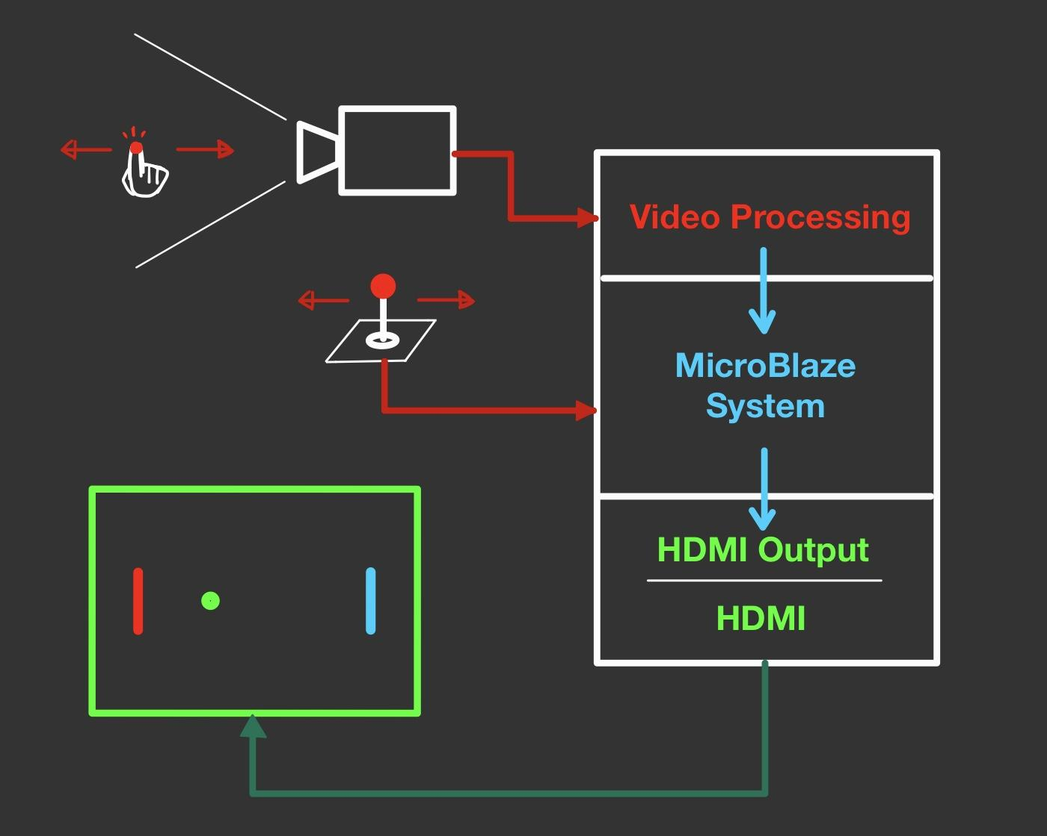
Overview

Slide 3
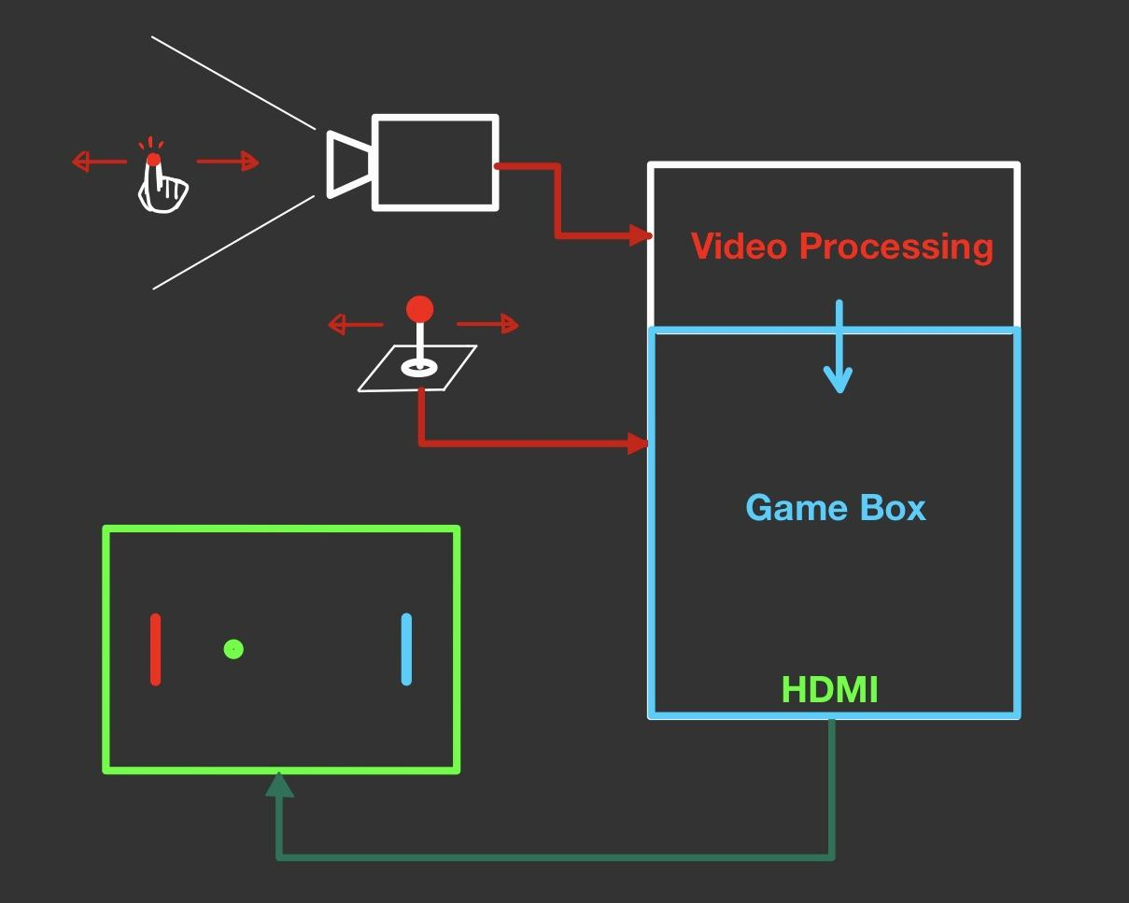
Overview

Slide 4
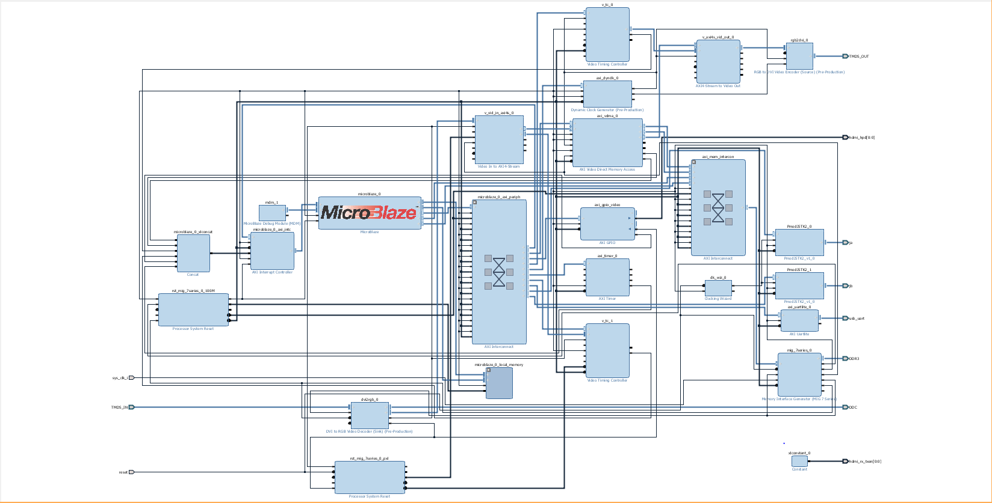
Block Diagram

Slide 5
Video Data Flow
VIDEO DMA
AXI STREAM TO VIDEO OUT
RGB to DVI Encoder
TMDS141 CHIP
HDMI
PORT
MEMORY INTERFACE
TIMING CONTROLLER

Slide 6
MicroBlaze + HDMI Output
DRAM BUFFER
Microblaze
WRITE
READ
Video DMA

Slide 7
MicroBlaze + HDMI Output
void drawPixel(int x, int y, int r, int g, int b) {
int iPixelAddr = x + (stride * y);
frame[iPixelAddr] = r;
frame[iPixelAddr + 1] = g;
frame[iPixelAddr + 2] = b;
}
// frame is a pointer to the DRAM buffer.
// iPixelAddr is the address of a single pixel in the buffer.

Slide 8
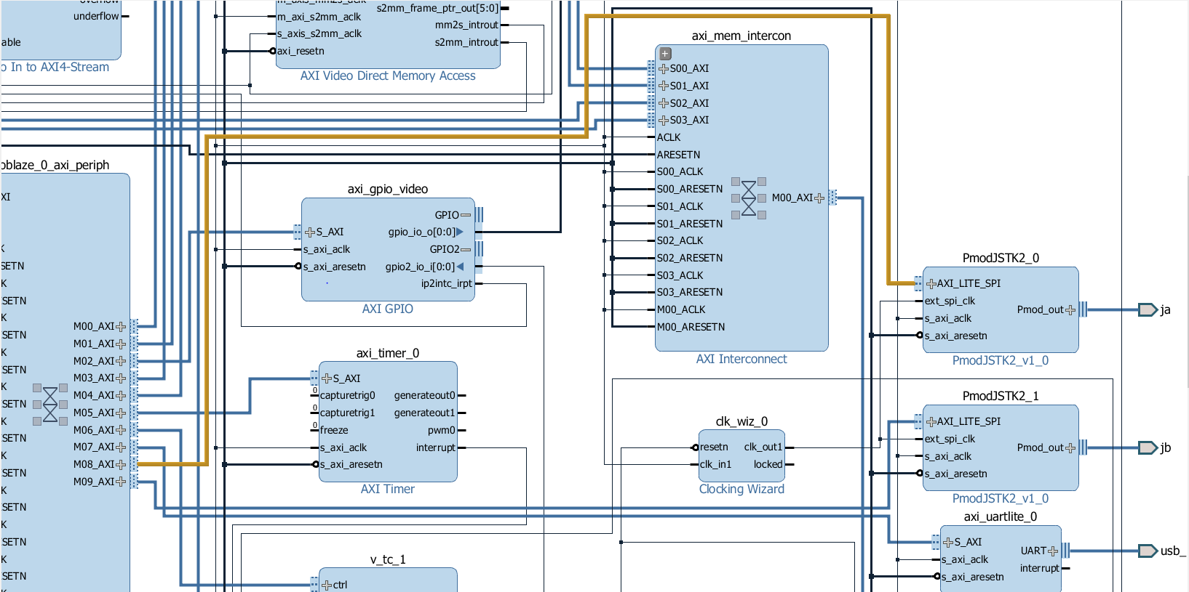
Block Diagram : Joysticks

Slide 9
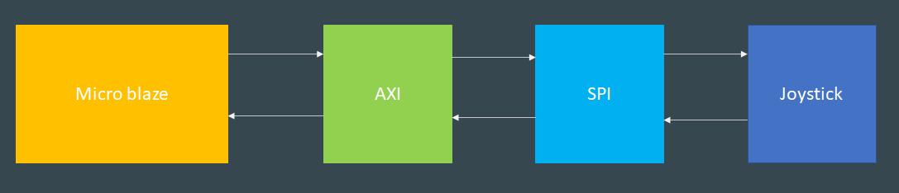
Joysticks: Interface with Microblaze

Slide 10
Joysticks: Code Interface
void update_player_pad(PmodJSTK2* player, player_pad* pad, ball_struct* ball, int t_elapse) {
u16 Ydata;
u16 Xdata;
float step;
pad->pX = pad->xPos;
pad->pY = pad->yPos;
Ydata = JSTK2_getY(player);
Xdata = JSTK2_getX(player);
step = JOY_STEP * (((float)(Ydata-128))/128);
pad->yPos -= step;
if (pad->yPos < pad->h / 2)
pad->yPos = pad->h / 2;
if (pad->yPos > SCREEN_HEIGHT - pad->h / 2)
pad->yPos = SCREEN_HEIGHT - pad->h / 2;
}

Slide 11
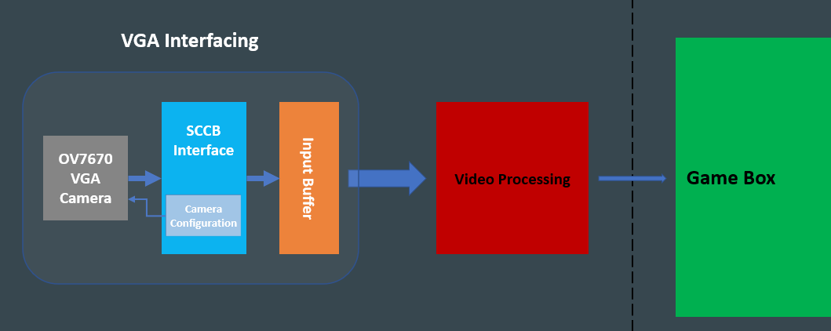
VGA Camera Interface

Slide 12
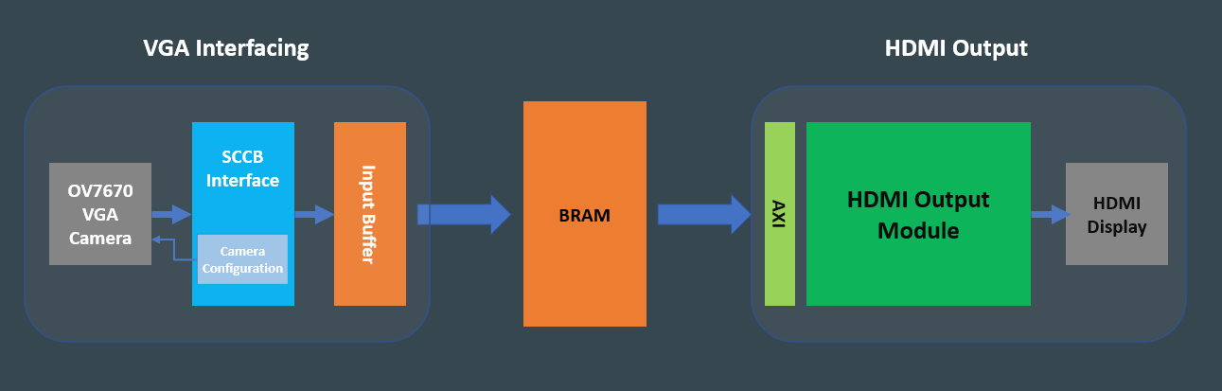
VGA Camera Verification

Slide 13
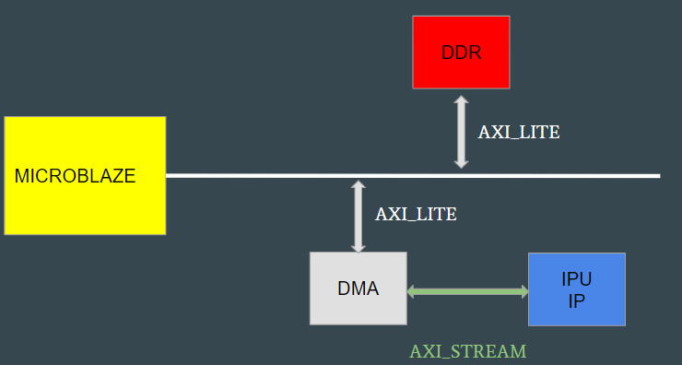
Image Processing Unit (IPU)
24 bits RGB2HSV Module
Masking HSV logic
IPU Logic
System Architecture

Slide 14
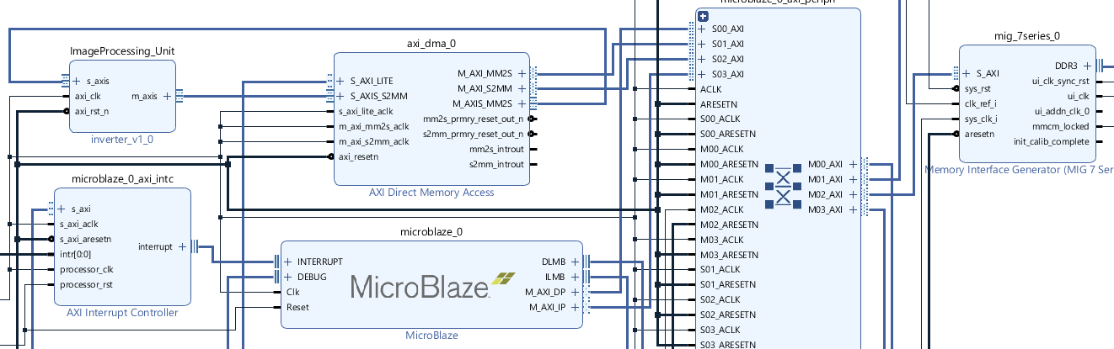
IPU BLOCK DESIGN

Slide 15

TEST IMAGE
BMP image
(Two fingers covered with blue & yellow cover)
UART
Save back to bmp file & visualize
Microblaze
RGB2HSV & mask values
HW IPU under development, tested functionality on SW

Slide 16
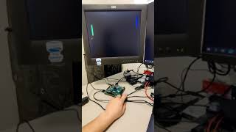
Demonstration

Slide 17
Thanks !
Q & A

